Slide 1

Running an analysis of combined data when the individual records cannot be combined:
practical issues in secure computation}
Gillian Raab, Chris Dibben, & Paul Burton
UNECE-Eurostat Work Session on Statistical Data Confidentiality, Helsinki , 2015

Slide 2
What is multi-party computation?
The data to contribute to an analysis are distributed across several sites
Confidentiality concerns prevent them being pooled for analysis
Methods have been developed to allow analyses to be carried out without pooling the data

Slide 3
Methods developed for this
Since around 2005
By statisticians who call it the analysis of distributed data
And computer scientists who call it privacy-preserving data mining (PPDM)

Slide 4
Horizontally or vertically partitioned data?
v1 | V2 | v3 | V4
v1 | v2 | v3
v4 | v5 | v6
Study 1
Study 1
Study 2
v1 | V2 | v3 | V4
Study 2

Slide 5
Horizontally partitioned data - examples
Genomic data
Adverse drug effects
Comparable surveys or censuses collected by different agencies

Slide 6
The UK Longitudinal Studies
Three studies each run by a different agency
England and Wales – (ONS LS)
Scottish Longitudinal Study – (SLS)
Norther Ireland Longitudinal study (NILS)
Each run by a different National Agency
Data needs to be held very securely (Census act)
The servers that hold the data have no internet access

Slide 7
The UK Longitudinal Studies
Three studies each run by a different agency
England and Wales – (ONS LS)
Scottish Longitudinal Study – (SLS)
Norther Ireland Longitudinal study (NILS)
Each run by a different National Agency
Data needs to be held very securely (Census act)
The servers that hold the data have no internet access

Slide 8
Methods for multi-party computation
Rely on exchanging and combining sufficient statistics from the different studies
For horizontally partitioned data, the sufficient statistics for the pooled data are just the sum over those from the individual studies
E.g. For regression inferences can be obtained from the sum of the information matrices (I)(X’X) and the score statistics (S) X’Y.
Coefficients are (∑I ) ⁻¹ ∑S
For iterative methods (e.g. GLMs) these quantities need to be exchanged at each iteration until the models converge.

Slide 9
Iterative estimation for GLMs
An analysis computer (AC) can control the estimation
Data is held on several data computers (DCs)
The following steps are needed
Starting values for the coefficients are sent to all DCs
Each DC returns their current I and S to the AC
The AC calculates a new value of the coefficients and checks if model converged
These steps are repeated until convergence

Slide 10
The DataSHIELD project
www.datasheild.org
Provides open source code to carry out these computations in the R package
They also provide a means of setting up an interface (opal server) between the AC and the DCs that restricts what objects can be transferred
In this protocol the AC controls all the analyses
After data harmonisation between the sites the AC establishes communication with each one and can then run a limited number of commands to extract data summaries from the DCs

Slide 11
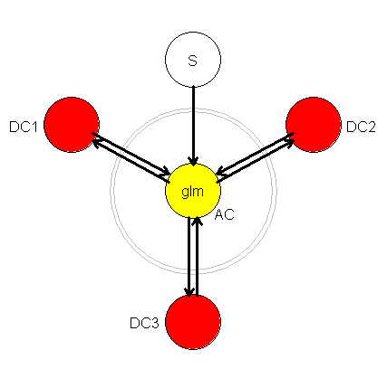
The DataSHIELD protocol
AC (yellow) controls the whole analysis
The interface restricts what can be extracted from the DCs

Slide 12
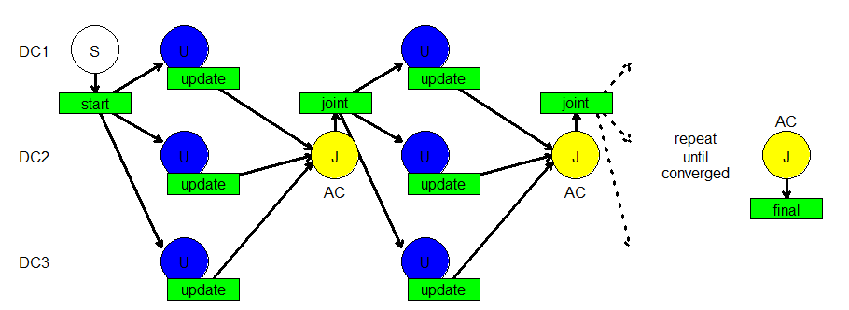
The E-DataSHIELD protocol

Slide 13
At each iteration an analyst at a DC must
receive a vector of coefficients from the AC by email
transfer it to the secure server via a secure data stick (for some LSs this transfer can only be done by agency staff, not be the individual researcher)
read it into their R workspace
run a routine to update the information matrix and score vector write them to a file
export the file from the secure setting via the secure data stick
email it to the AC.

Slide 14
At each iteration an analyst at a DC must
receive a vector of coefficients from the AC by email
transfer it to the secure server via a secure data stick (for some LSs this transfer can only be done by agency staff, not be the individual researcher)
read it into their R workspace
run a routine to update the information matrix and score vector write them to a file
export the file from the secure setting via the secure data stick
email it to the AC.

Slide 15
Features of the E-DataSHIELD method
Automatic calculation of starting values
Fits a whole set of models together and stops when they have all converged
Generates the names of the files to transfer automatically at each iteration, and then checks that everything is as it should be.
Other routines available for pre-analysis harmonisation and summaries of data and presentation of results
Two projects using the LSs have used this methodology successfully

Slide 16
Secure multi-part computation
The individual parts of the summaries are encrypted using homomorphic encryption
Simplest example of this (used by statisticians) is for the first DS to add a random number to their result and pass it round the others, then when it comes back to the first one the random number is subtracted
Computer scientists use more sophisticated ones
But it wouldn’t work with DataShield

Slide 17
The DataSHIELD protocol
DCs don’t communicate with each other
But no reason why it should not work with E-DataShield

Slide 18
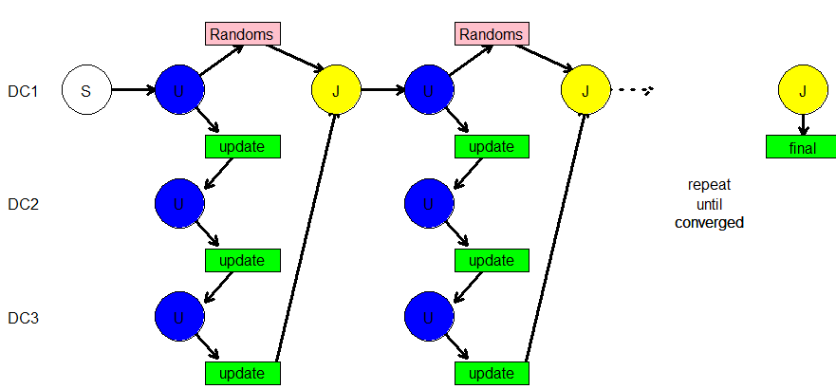
E-DataSHIELD with secure summaries

Slide 19

E-DataSHIELD
package
eds
Will shortly to be submitted to CRAN
http://cran.r-project.org/package=eds
Notes:
Make sure that users don’t confuse it with simPop package!

Slide 20
Sample eds code
At each DC
>eds.glm.update("spine",itno=1,data=SEast,quietly=T)
File written Project_spine_Itno_1_Study_2.R
Now email file to analysis computer
At the AC
> eds.joint.update(project="spine",itno=1,studies=1:3,quietly=T)
which gives the message
0 out of 3 models converged
File written: Joint_fit_project_spine_Itno_2.R .

Slide 21
Sample eds code with secure summaries
At the first DC
>eds.glm.update("spine",itno=1,data=London,quietly=F,secure=T)
Result read from file Start_project_spine_Itno_1.R
Fitting 3 models for project spine at iteration 1
File with random objects is written as Project_spine_Itno_1_Randoms.R
Result for project spine iteration 1 study 1
written to file Project_spine_Itno_1_Study_1.R
Now email file to next data computer, study 2
At the next DC
Same commands but the random file is only written by the first DC
And at the next iteration the first DC reads it before the Joint update and writes a new one for the next iteration
.

Slide 22
Further points in the written paper
Examples of how the results of the analyses can be computed
How covariate by study interactions are fitted
An example using synthetic data generated from one of the LSs
References to other papers

Slide 23
Conclusions
We have a package that works for the LSs
We plan to make it publicly available via CRAN
And hope it will be useful to others
More details and future directions in the published paper
Farr Institute International Conference 2015 | Joshua Snoke, Beata Nowok, Gillian M. Raab, Chris Dibben, and Aleksandra B. Slavković | 27 August 2015

Slide 24
Acknowledgments
We are grateful to the DataSHIELD project for having introduced us to these ideas and shared their code with us. Also to the staff of the LSs for helping us to develop eds.
The DataSHIELD project is supported by funding from: the European Union’s Seventh Framework Programme - BioSHaRE-EU (Biobank Standardisation and Harmonisation for Research Excellence in the European Union); a strategic award from MRC and Wellcome Trust for the ALSPAC project; and the Welsh and Scottish Farr Institutes, MRC funded E-Health Informatics Research Centres (EHIRCs).
Farr Institute International Conference 2015 | Joshua Snoke, Beata Nowok, Gillian M. Raab, Chris Dibben, and Aleksandra B. Slavković | 27 August 2015
Notes:
Can you please also add: NSF Award BCS-0941553 since Joshua’s stipend for this summer is from this grant.

